Slide 1

Self - Balancing
Robot
-Course- Embedded and Cyber-Physical Systems(CS637A)
-Dept. of computer science and engineering
-Instructor - Dr. Indranil Saha
-Indian Institute of Technology, kanpur

Slide 2
Group Members
-Pooja Choudhary
-Devyanshu Singh
-Rahul Aggarwal

Slide 3
Introduction
The robot represents a unique solution problem of control of a two wheeled inverted pendulum.
Wheeled inverted pendulums: are intrinsically nonlinear and their dynamics will be described by nonlinear differential equations. Despite this, for the case of controller design, it is often possible to obtain a linearized model of the system. If the system operates around an operating point, and the signals involved are small signals, a linear model that approximates the nonlinear system in the region of operation can be obtained.

Slide 4
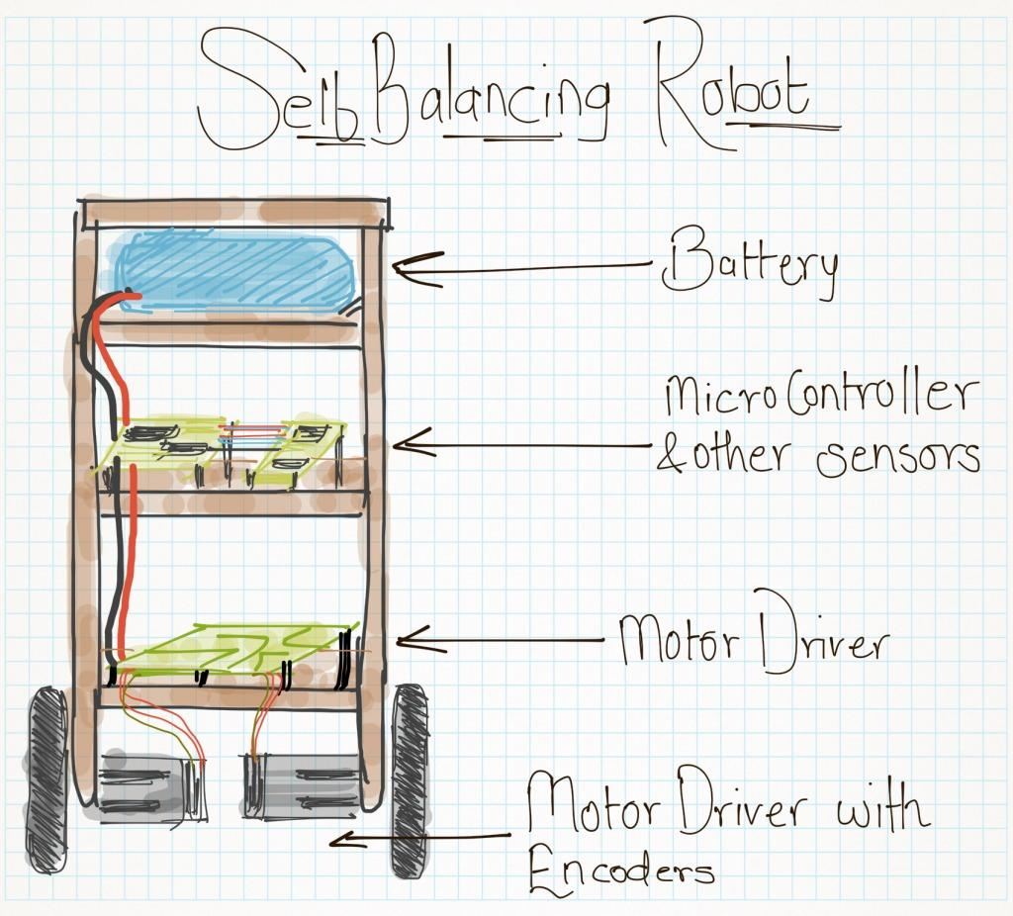
A real life simulation

Slide 5
PID controller on TWSB
The PID is used for the purpose of balancing the robot to stand still at upright position and to receive command via terminal to follow the desired trajectory smoothly.
The PID gains were tuned until the optimum values are achieved. The Arduino based PID-controller was implemented on the TWSB robot in real world experiment. The experimental result shows the effectiveness of the proposed controller for stabilization and trajectory tracking control of TWSB robot.
Notes:
Proportional Integral Derivative -PID
Two-wheeled self-balance (TWSB) robot
The dynamic model of TWSB robot was developed using Lagrangian method.

Slide 6
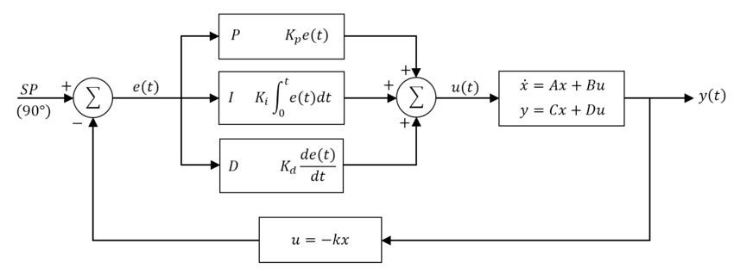
Self-balancing robot use a “closed-loop feedback control” system; this means that real-time data from motion sensors is used to control the motors and quickly compensate for any tilting motion in order to keep the robot upright. This equation is computed frequently through microcontroller at a very high frequency. Thus several addresses need to be made such as sampling time, derivative error, tuning, reset windup and on/off.

Slide 7
PID Controller
K_{p} - determines amount of restoring force that should be applied to overcome position error. ‘P’ constants depends on the value of the current error.
K_{i} - increases with time at the end of the move. And pushes system to zero positioning error. Used primarily when the system experiences static loads. ‘I’ constant is the accumulation of previous error value.
K_{d} - reduces overshoot and oscillations. Proportional to rate of change of error. ‘D’ constant is the future prediction error, based on the changes rate.
e(t) (error value) - difference between a set point (SP) and a measured process variable (PV).
u - controller output

Slide 8
Working
Three controls will be designed:
First one to control the robot balance.
Second is, distance controller for the forward or backward movement control,
The last one is for maneuver or steering.

Slide 9
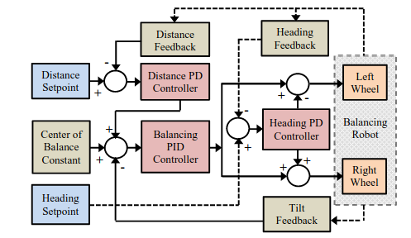
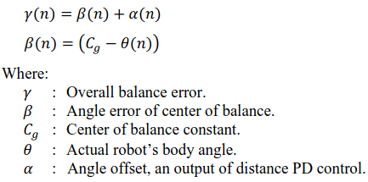
Overall PID Diagram
Robot is designed to have the center of gravity located in the center when the robot is standing 90 degrees from the floor to make it easier reaching the balance state. The tilt sensor is placed inside and parallel with the robot’s body. When the robot is tilting forward, the 𝜭 becomes negative and when the robot is moving forward and the distance control calculated the output 𝛂 will be positive against 𝜭. So when the target distance is increased in the distance set-point, the robot’s body will increase the tilt angle forward as long as the distance target not achieved.

Slide 10
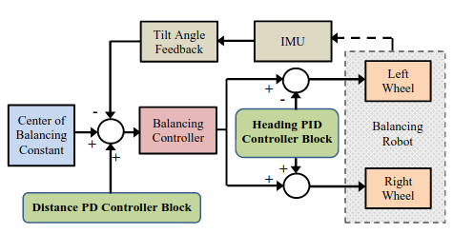
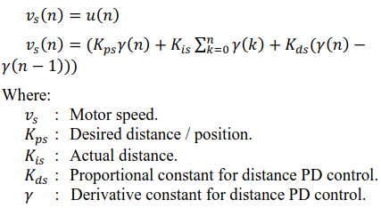
Balancing PID Control
This control is used to maintain the robot balance by controlling the robot standing position by using its tilt angle feedback. Because of the angle needs to be corrected while moving, this control input is the sum of both angle error (𝛃) and angle offset (𝛂) which is the output of distance PD controller.
Notes:
Based on experiment, the best value for the proportional constant is 175.0, derivative constant is 8.5, while for the integral constant is 5.0.
An IMU is a specific type of sensor that measures angular rate, force and sometimes magnetic field.

Slide 11
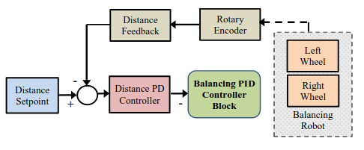
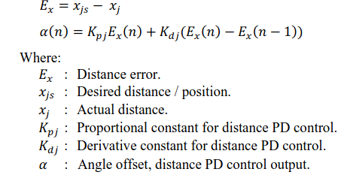
Distance PID Control
In this research distance is used as a parameter for movement, forward or backward. Output of this control affect the robot’s tilt error by being an input for the angle PID control.
X_{j} is the distance pulse averaged from two rotary encoder mounted on both right X_{r} and left wheel X_{l}.
Notes:
Based on trial and error experiment, best value found for proportional constant is 0.0005 while for the derivative constant is 0.75

Slide 12
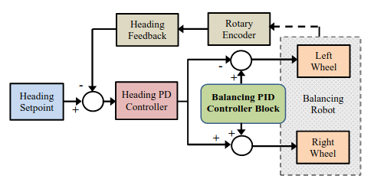

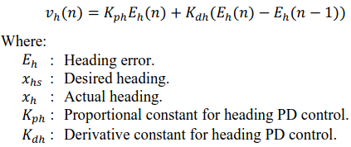
Steering PID Control
A PD control is used to control the orientation of the robot. Orientation data is taken from rotary encoder which will count the pulses generated by the wheel.
X_{h} is the heading of the robot, and X_{l} is the left pulses which is subtracted by the right rotary encoder pulses X_{r}.
Notes:
the best value for proportional constant is 2.0 while the derivative constant is 0.75.

Slide 13
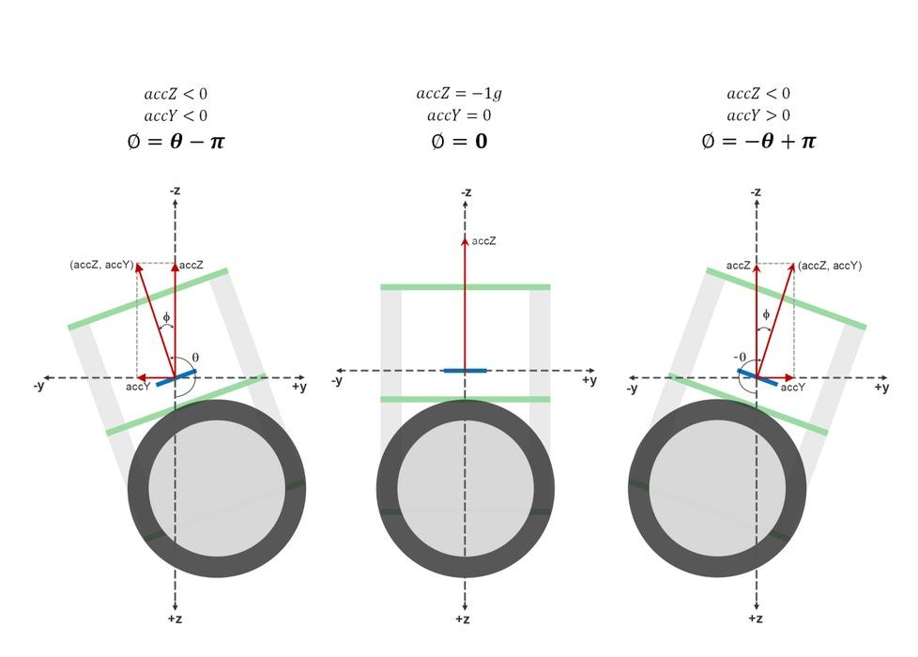
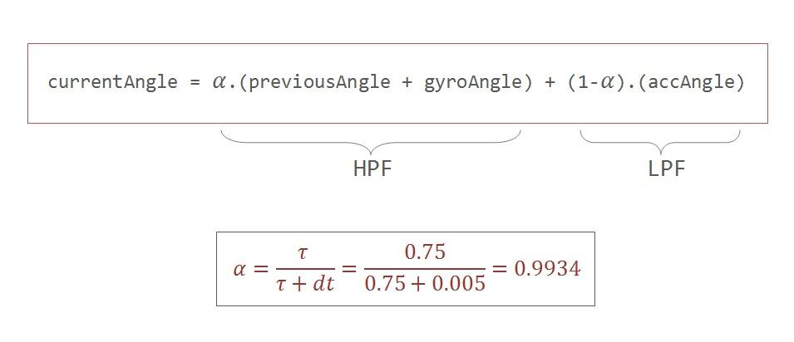
Notes:
HPF - High Pass Filter (works as an differentiator), allows high frequencies to pass through while blocking low frequencies.
LPF - Low-pass filter can work as an Integrator,

Slide 14

Simulation
Notes:
3.mkv - https://drive.google.com/file/d/19jFb2lDAesJpzlNhi1EEVjTE0hrBX5hW/view?usp=share_link
4.mkv - https://drive.google.com/file/d/1eIDho8lPaHNcQSx5-bwH-oPz2EHm5KZ1/view?usp=sharing

Slide 15
Simulation with sidewards movement
Notes:
https://drive.google.com/file/d/11T7wgjsYdBmuyBe7eDRr8brY_nOqtaC9/view?usp=share_link

Slide 16
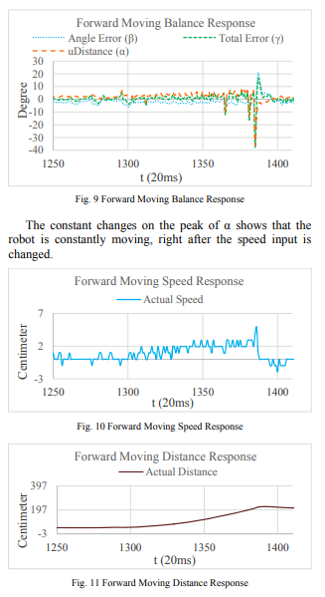
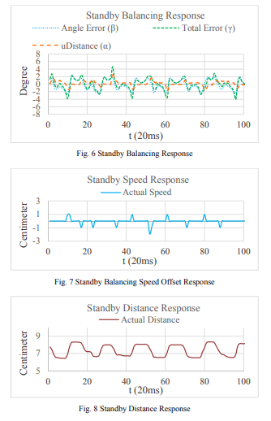
Results

Slide 17
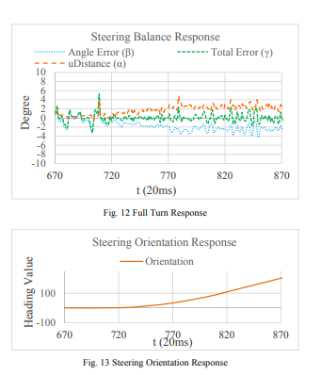

Slide 18
Conclusion
PID control that uses tilt and position error can maintain the robot balance while doing maneuver. It also able to move the robot’s position by correcting the body’s tilt.
The control system, is able to do maneuver and changing robot’s position while maintaining the body balance.
The distance control, able to move the robot’s position.
The steering control, is able to change the orientation without disturbing the balance control with an acceptable heading error.
Notes:
The experiment shows that the robot is able to climb up on 30 degree sloping board. By cascading the distance control to the balancing control, the robot is able to move forward, turning, and reach the desired position by calculating the body’s tilt angle.

Slide 19
Limitations
Cannot operate on inclined surfaces with more than 30⁰.
Less control on high speeds.
Will require optimization of the mechanical design such as
relocating the center of mass,
better sensor placement,
modification of the complementary filter to reject disturbances due to translational motion, and
a robust control design

Slide 20
Work station
Simulations were done on Gazebo and Robot Operating System (ROS).
‘hector_gazebo_plugins’ provides gazebo plugins contains a 6wd differential drive plugin, an IMU sensor plugin, an earth magnetic field sensor plugin, a GPS sensor plugin and a sonar ranger plugin.
Notes:
An IMU is a specific type of sensor that measures angular rate, force and sometimes magnetic field.

Slide 21
References
https://link.springer.com/chapter/10.1007/978-3-319-95165-2_48 (2018)
https://ieeexplore.ieee.org/stamp/stamp.jsp?tp=&arnumber=7380821&tag=1 (2015)
https://www.wikipedia.org/

Slide 22
Thank You and new section added below

Slide 23
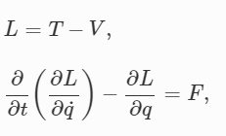
Mathematical MOdelling
The robot chassis and the two wheels are rigid, (2) The left and the right wheels are having the same mass (m) and radius (r). The distance between each wheel to the center of mass are equal (lr=ll=l/2).
There is a true rolling and no slipping during the motion,
Internal losses are neglected and,
Inductance and frictions on the armature are not considered.
The TWSB robot is considered to possess three degree of freedom, consisting of yaw angle (γ), tilt angle (α), and translational motion (x). The two Lagrangian equations are as follows:
where L is the Lagrangian, T is the kinetic Energy, V is the potential energy, F is the forced function, qx is the generalized coordinates

Slide 24
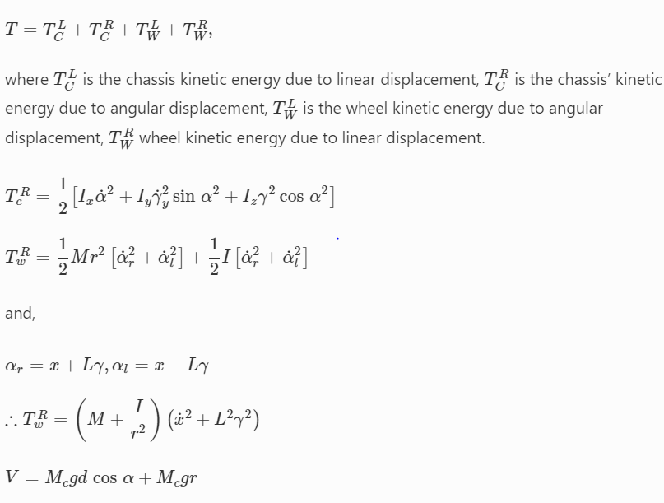
This robot has been controlled by two inputs torques applied to the motors produced by voltage.

Slide 25
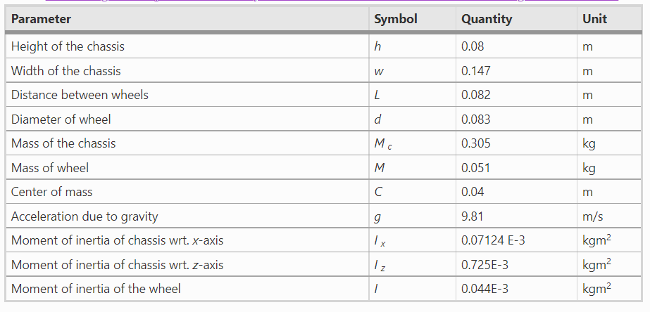
Further mathematical modelling is taken from [1]. Robot Parameters.

Slide 26
Contributions
Pooja Choudhary
(33%)
Devyanshu Singh
(33%)
Everyone contributed equally
Rahul Aggarwal
(33%)

